Slide 1
Freshman Orientation
House Bill 5 (HB 5)
Graduation Requirements

Slide 2
What is House Bill 5?
House Bill 5 (HB 5) is a law passed during the Texas 83rd Legislative session that changed graduation requirements for students entering 9th grade (current 8th grade students) during 2014-15 school year.

Slide 3
House Bill 5
HB5 is designed to allow students more flexibility in the selection of their high school courses to prepare them to either pursue a traditional path into colleges and universities or move directly into the workforce.
Creates the new Foundation High School Diploma program that affords all students a variety of post- secondary opportunities.

Slide 4
House Bill 5
Allows students to earn an endorsement in one of five areas:
• Science, Technology, Engineering, Mathematics (STEM),
• Business and Industry,
• Public Services,
• Arts and Humanities, and
• Multidisciplinary.
Requires a student entering 9th grade 2014-15 school year and thereafter to enroll in the courses necessary to complete the requirements for the Foundation High School Program and requirements for at least one endorsement.

Slide 5
House Bill 5
Replaces current Minimum, Recommended, and Distinguished Achievement Graduation Plans.
Allows for current 9th, 10th, and 11th grade students to choose to graduate under their current plan or opt for the new graduation plan created by House Bill 5.

Slide 6
House Bill 5
Reduces the number of End of Course (EOC) Assessments students are required to pass for a high school diploma from 15 to 5. They are:
• English I
• English II
• Algebra I
• Biology
• U. S. History
Combines English exams into one assessment instead of separate reading and writing tests.

Slide 7
Foundation High School Program
4 credits in English language arts
English I, English II, English III, Advanced English Course
3 credits in Mathematics
Algebra I, Geometry, Advanced Mathematics Course
3 credits in Science
Biology, IPC or Advanced Science Course, Advanced Science Course
3 credits in Social Studies
US History, Government (.5), Economics (.5), W Geography or W History
2 credits in Languages Other than English
1 credit in Fine Arts (community-based fine arts program can substitute)
1 credit in PE (private or commercially sponsored physical activity may substitute)
5 credits in electives
(22 Credits)

Slide 8
Foundation High School Program with Endorsements
What is an Endorsement?
An endorsement is earned when a student completes a sequence of courses in a concentrated area of study.
Endorsement Areas:
Science, Technology, Engineering, Mathematics (STEM)
Business and Industry
Public Services
Arts and Humanities
Multidisciplinary

Slide 9
STEM Science, Technology, Engineering, Mathematics
The science, technology, engineering, and mathematics (STEM) endorsement includes courses directly related to science, including environmental science, technology, computer science, engineering, and advanced mathematics.
POSSIBLE CAREERS FOR STEM ENDORSEMENT
Engineer Meteorologist
Forensic Scientist Neurobiologist
Computer Programmer Computer Technician
Mathematician Scientist
Environmental Science

Slide 10
Business and Industry Endorsement
The business and industry endorsement includes courses directly related to database management, information technology, communications, accounting, finance, marketing, graphic design, architecture, construction, welding, logistics, automotive technology, agricultural science, and heating, ventilation, and air conditioning.
POSSIBLE CAREERS IN BUSINESS AND INDUSTRY
Purchasing Agent Media Director
Web Designer Architect
Accountant Financial Analyst
HVAC Technician Automotive Technician
Welder Chef

Slide 11
Public Services Endorsement
The public services endorsement includes courses directly related to health sciences, human services, education and training, government and public administration, and law enforcement.
POSSIBLE CAREERS IN PUBLIC SERVICES
Police Officer FBI Agent
Pharmacist Social Worker
Teacher Nurse
Military Officer Firefighter
Medical Records Technician

Slide 12
Arts and Humanities Endorsement
The arts and humanities endorsement includes courses directly related to political science, world languages, cultural studies, English literature, history, and fine arts.
POSSIBLE CAREERS IN ARTS AND HUMANITIES
Photographer Musician
Fashion Designer Actor
Writer Historian
Politician Digital Artist
Graphic Designer Studio Artist

Slide 13
Multidisciplinary Studies Endorsement
Allows a student to complete prescribed courses from each of the four foundation subject areas, advanced placement courses from each of the four foundation subject areas or four advanced courses from within one endorsement area or among endorsement areas not in a coherent sequence.

Slide 14
Foundation High School Program with Endorsements
To earn any endorsement, a student must successfully complete the requirements for the Foundation High School Program (22 credits) and:
•An additional advanced mathematics course = 4 credits mathematics
•An additional advanced science course = 4 credits in science
•2 elective credits in addition to the elective credits required for the FHSP
(26 Credits Total)

Slide 15
How Will Students Select an Endorsement?
Each 8th grade student will complete an educational plan of study (4 year plan) based on his/her interests.
    The educational plan of study designates which endorsement the student will pursue.
    Students may earn more than one endorsement.
The educational plan of study will be sent home for parental input and approval.

Slide 16
Distinguished Level of Achievement
A student may earn a distinguished level of achievement by successfully completing:
•A total of four (4) credits in mathematics which must include Algebra II
•A total of four (4) credits in science
•The curriculum requirements for at least one (1) endorsement
Students must graduate at the Distinguished Level to qualify for top 10% automatic admissions to Texas public colleges and universities.

Slide 17
Performance Acknowledgements
A student may earn a performance acknowledgement on the student’s diploma and transcript by completing one of the following:
• 12 hours in dual credit courses with a grade of A or B,
• achieve National Merit/Commended Scholar on PSAT, SAT (combined critical reading and mathematics score of 1250), or the ACT (composite score of 28),
• earning an industry-based license or certification.

Slide 18
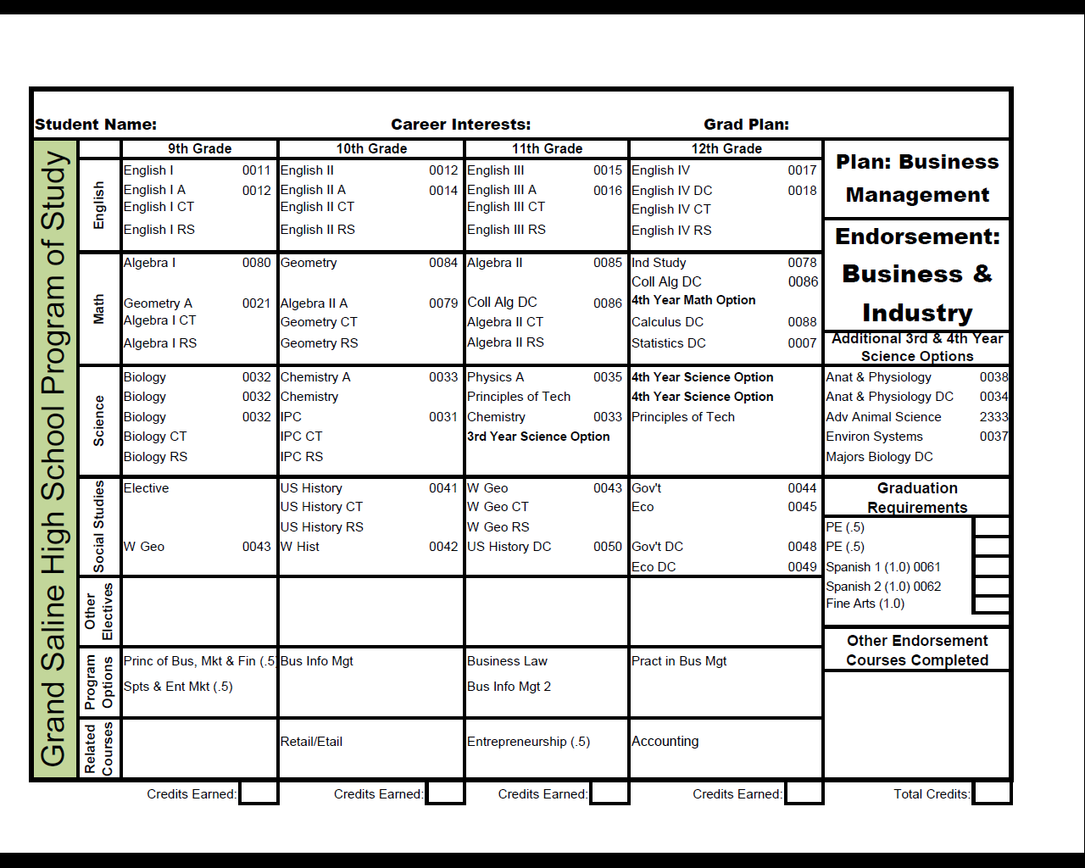

Slide 19
STEM
Math
  Algebra I , Geometry, Algebra II and 2 advanced math courses
Science
  Biology, Chemistry, Physics and 2 advanced science courses
Career & Technical Education (CTE)
  4 CTE credits w/2 credits in the same cluster that lead to final course in the STEM cluster
Combination
  Algebra 2, Chemistry and Physics and additional math course, additional science course and 3 additional credits from CTE in the STEM endorsement

Slide 20
Business and Industry
CTE
  Metal Fabrication
  Horticulture
  Wildlife
  Hospitality
  Marketing
English
  Yearbook
Technology
  Arts, Audio/Video Technology and Communication
  Information Technology
Agribusiness
Business Management
Finance
Animal Science

Slide 21
Arts and Humanities
Social Studies
  5 credits
Foreign Language
  4 levels of the same foreign language
Fine Arts
  Four courses in the same area
  2 courses in one area and 2 courses in a different fine arts area

Slide 22
Public Services
CTE
  Health Science
  Human Services

Slide 23
Multidisciplinary Studies
Four by Four
  4 English credits
  4 Math credits
  4 Science credits
  4 Social Studies credits
Dual Credit
  Four DC courses for 4 credits in English, math, science, social studies foreign language or fine arts
CTE
  Four advanced course that prepare students to enter the workforce or postsecondary education

Slide 24
So what happens now?
Step 1: Counselors will meet with students to review their educational plan of study (4 year plan) and endorsement selection. Students will be given an opportunity to change their plan yearly.
Step 2: Educational plans of study will be sent home for parental input and approval.

Slide 25
So what’s next?
Know graduation requirements
  5 credits must be earned to become a 10th grader
Become Involved
  Extra-curricular
  Community service
  Leadership
  Summer academic programs
  Athletics
Prepare document organizer
  Academic records
  Activities
  Awards
College and Career Readiness
  Maintain good grades
  College entrance is determined by GPA, rank and scores on college entrance exams (SAT/ACT)

Slide 26
For questions, please contact your student’s counselor.
Dr. John Abbott, Grand Saline Middle School
903-962-7537
jabbott@grandsalineisd.net
Robin Goff, Grand Saline High School
903-962-7533
rgoff@grandsalineisd.net

